Slide 1
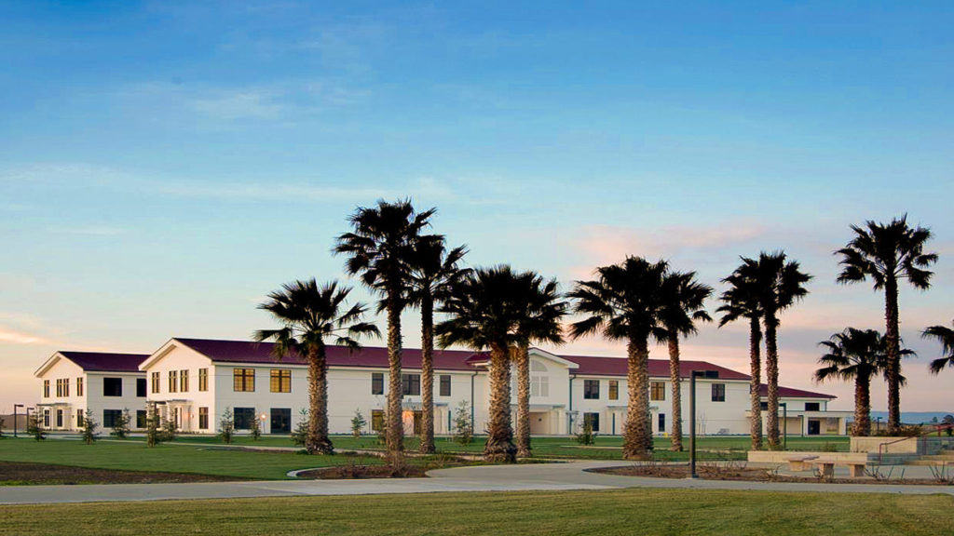

WCC STRATEGIC PLANNING
EMP & Student Equity Plan

Slide 2
Timeline
July 2025
6 Aug 2025
8 Aug 2025
Aug 2025
Sept - Oct 2025
STEERING COMMITTEE COMMUNICATION
Invitation to the Steering Committee Kickoff on August 6, homework, and presentation of the planning process
STEERING COMMITTEE KICKOFF
Facilitated engagement to:
a) agree on the outcome, roles, and timeline
b) receive guidance from President on vision formation
c) form the hindsight needed to move toward a future vision
d) draft a future vision inclusive of elements from the past and present to carry into the future
STAKEHOLDER VISIONING WORKSHOP(S)
Two 1-hour facilitated workshops with approximately 30 invited stakeholders per workshop in a ‘max-mix’ arrangement to hear their aspirations for WCC
CONSOLIDATION OF FUTURE VISION INPUT
Form a ‘North Star’ vision for the WCC strategic plan, and consider:
an aspiration summary statement that would inspire our campus and supporters
a metaphor and symbolism to describe the vision and outcomes of our effort
STRATEGY AND GOAL FORMATION
Formation and articulation of our path forward inclusive of the bold steps needed, objectives, tactics, key performance indicators, and a roadmap for implementation
Vision and goal setting workshop with Student Equity Group and incorporates the Student Equity Plan content
Goal-setting workshop
Nov 2025 - end of Jan 2026
Feb - Mar 2026
Mar - Apr 2026
Spring 2026
Date TBD
COMMUNICATION OF THE DRAFT PLAN FOR FEEDBACK
Invitation to the broader campus community to provide feedback on the draft strategic plan
PLANNING DOCUMENT REFINEMENT
Finalization of the strategic plan content
PUBLICATION PREPARATION
Prepare the strategic plan for public presentation inclusive of a roll-out strategy
PRESENTATION OF THE 2026 - 2030 STRATEGIC PLAN
IMPLEMENTATION UNDERWAY

Slide 3
Align Student Equity Plan Metrics
Successful Enrollment
Persistence
Transfer-level
Math & English
Transfer to
4-Year
Completion

Slide 4
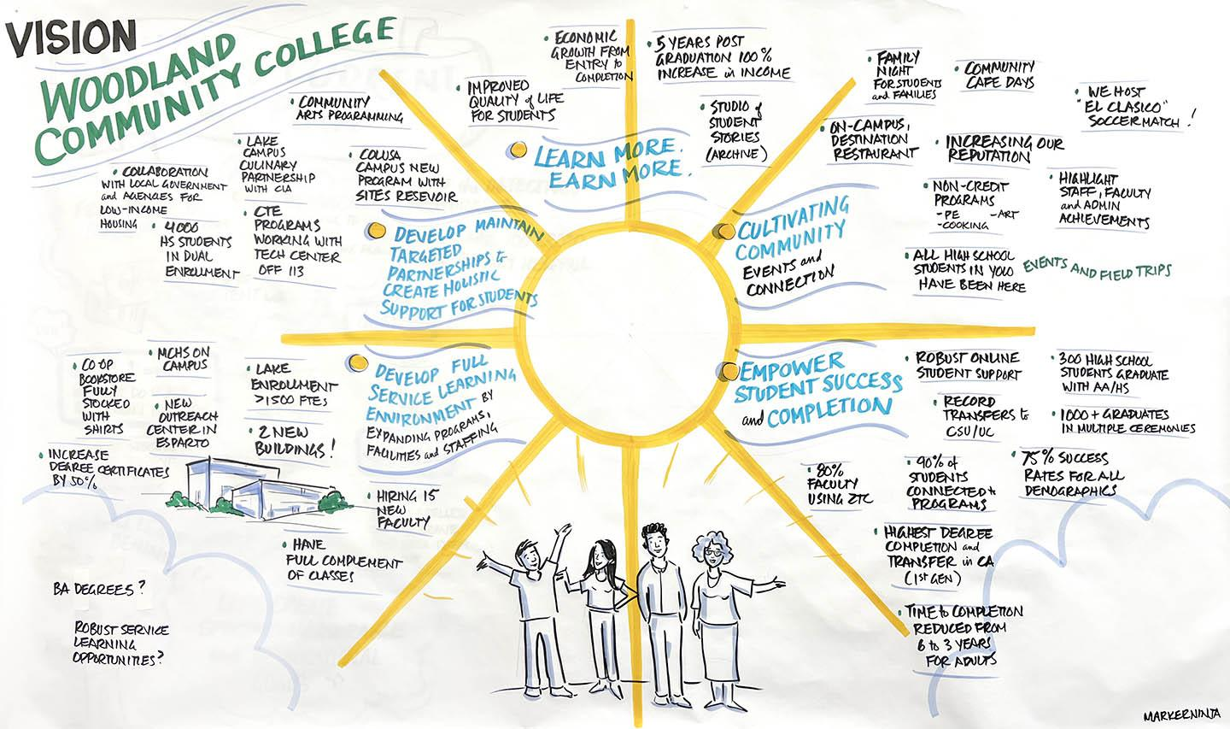
Summary - August 6, 2025
Steering Committee Workshop

