Slide 1
Institutional Self Evaluation Launch and Training
WELCOME!
September 28, 2022
Notes:
ALO starts

Slide 2
Topics for Today
Part One: Accreditation Context
Accreditation Purposes & Processes
ACCJC Expectations & Current Practice
Part Two: Nuts/Bolts Developing ISER
Interpreting the Standards for Self-Evaluation
Developing the ISER: Tips & Resources
After the ISER: What to Expect
Notes:
ALO share excitement, explain how Gohar will cover in two parts the training, will include breaks

Slide 3
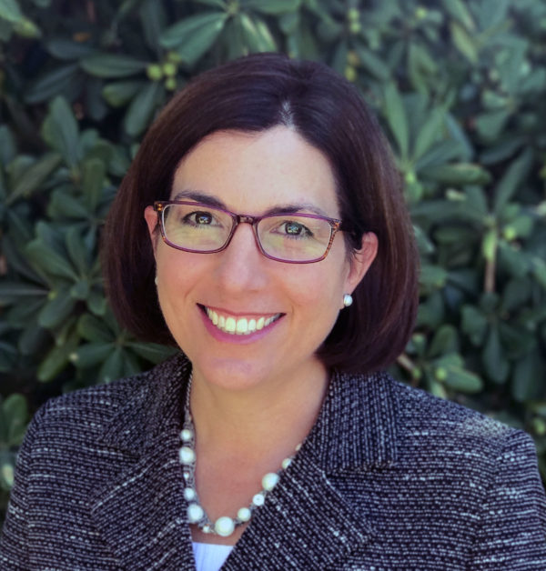
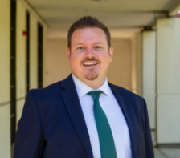
Co-Facilitators
Dr. Gohar Momjian
Vice President, ACCJC
Your ACCJC Staff Liaison
Kasey Gardener
Vice President of Instruction
Accreditation Liaison Officer
Notes:
ALO acknowledge getting geared up, emphasize this work provides opportunity to engage entire college
toss mic to Gohar
Gohar: explain my role as staff liaison – partnering with institution in support of their mission and quality
-Becomes immersed in your institution’s mission, culture, and student populations; Primary point of contact for accreditation activities;
Provides trainings and resources; ISER development; point of contact with college and resource for peer review team and Commission (clarity, consistency, context); work closely with ALO as college point of contact and with president

Slide 4
Learning Outcomes
Understand the ISER in context of the accreditation process
Engage in the self-evaluation process as an opportunity to document and establish goals for continuous improvement
Interpret Standards and apply them to your College/District policies and practices
Write a concise, clear, and evidence-based ISER
Notes:
Gohar

Slide 5
Broader Context for Accreditation

Slide 6
What is Accreditation?
In 1 to 3 words describe accreditation:
Accreditation is….:
?
?
?
Notes:
https://www.menti.com/cn9od8ne75

Slide 7
What is Accreditation
Accreditation is a practice of academic quality control
Promotes institutional excellence through application of standards
Advances meaningful and effective student learning and achievement
Provides assurance to students, general public, & others of quality of educational offerings
In the United States we are fortunate that this is a peer review driven process. In many other countries, colleges and universities are recognized by a government education agency, such as the Ministry of Education.

Slide 8
Why Does Your College Seek Accreditation?
Top Three Reasons:
?
?
?
Notes:
Gohar ask to Type in chat

Slide 9
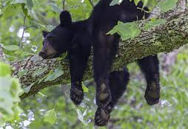
Why Bother?
Access to Title IV (Federal Student Aid)
Credibility to degrees and credentials (transfer & employment)
Assure quality to the public and students
Stimulates institutional innovation and improvement
Provides quality assurance to students, the public, and other institutions that you are achieving your mission
Notes:
-institutional effort over 2 yr period, reaffirm reasons they mentioned
Benefits of this practice:
-Gives credibility to degrees and credentials awarded to students (transfer and employment)
-Stimulates institutional innovation and improvement
-Enables access to Title IV (Federal Student Aid)
-Provides quality assurance to students, the public, and other institutions that your Colleges are achieving their missions

Slide 10
Who ACCJC Accredits
Public and private colleges with primary mission of granting associate degrees (may also award certificates and other credentials, including bachelor’s degrees) in:
California
Hawaii
U.S. territories of Guam and American Samoa
The Republic of Palau
The Federated States of Micronesia
The Commonwealth of the Northern Marianas
The Republic of the Marshall Islands
Notes:
-135 institutions in our region, 114 CA community colleges, private, non-profit/for profit, Islands, more than 2.1 million students,

Slide 11
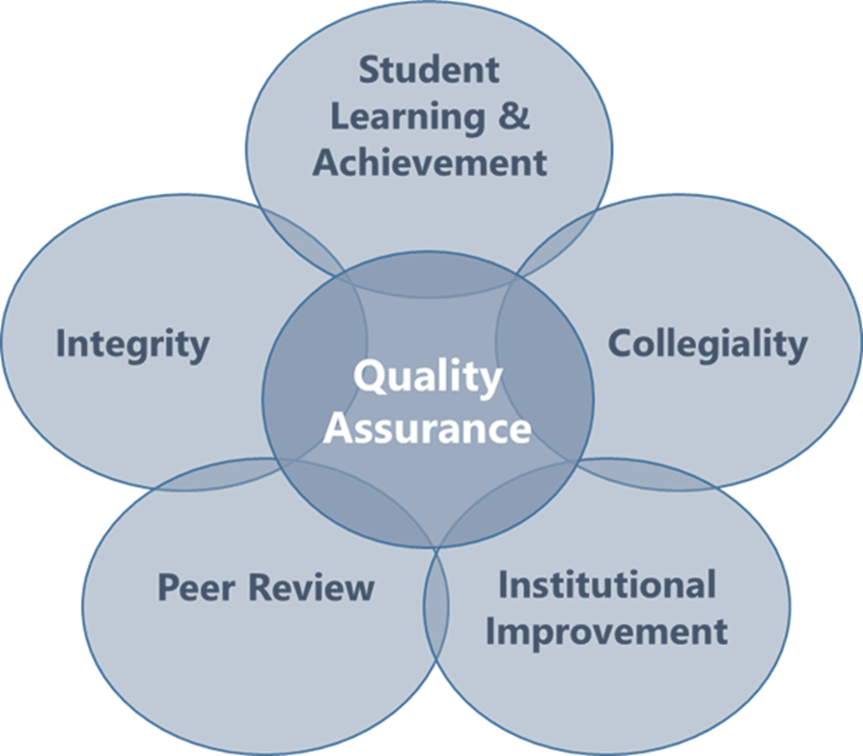
ACCJC Mission in Action
Outcomes
Innovation
Improvement
The ACCJC supports its member institutions to advance educational quality and student learning and achievement. This collaboration fosters institutional excellence and continuous improvement through innovation, self-analysis, peer review, and application of standards.
Notes:
Like our member colleges, we have a mission here at ACCJC which is what you see here on the screen.
We also have a strategic plan and core values which guide the work we do and how we engage with our members.

Slide 12
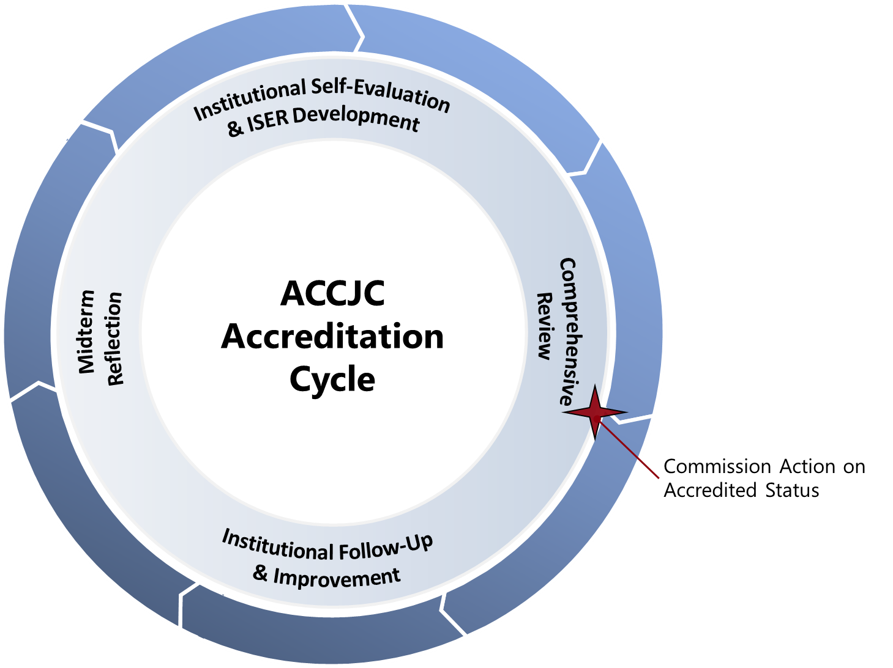
Accreditation Cycle and Reports
At a Glance
Self Evaluation & Comprehensive Review (every 7 years)
Follow Up Reports (if required)
Midterm Reporting (4th year after comp review)
Ongoing Reporting
Annual Report
Annual Fiscal Report
Substantive Change
Notes:
-accreditation based on 7 year cycle
-institutions conducts its own self evaluation and then validated by peers
-process designed to help institutions improve and focus on effective institutional processes and improving student outcomes
-throughout 7 years, monitoring activities
-touchpoint mid-cycle
-review of the college is in context of its mission
Monitor certain aspects of institutional quality per federal regulations
-Fiscal Health
-Headcount growth or decline
-Substantive Changes

Slide 13
Overview: The Accreditation Evaluation Process
Self-Reflection (ISER)
Peer Review (Team ISER Review & Focused Site Visit)
Affirmation (ACCJC Action)
Ongoing Commitment to Improvement & Educational Excellence
Notes:
-beginning of process not end test,
-Institutional Self Evaluation Report (ISER) – clean slate, prior history of reports not considered
-Peer Review Team/Formative and Summative Components: concluding in Team Report with Recommendations (for improvement or for compliance); Commendations;
-Commission action – accreditation status

Slide 14
Four Interconnected Standards of Institutional Practice
Standard I
Standard II
Standard III
Standard IV
Mission
Instructional Programs
Human Resources
Decision-Making Roles & Processes
Physical Resources
Chief Executive Officer
Assuring Academic Quality & Institutional Effectiveness
Library & Learning Support Services
Technology Resources
Governing Board
Institutional Integrity
Student Support Services
Financial Resources
Multi-College Districts
Notes:
3 min.
emphasize standards are descriptions of good practice; to provide guidance on what makes a quality institution, emphasize developed and revised through peer process, together improving what quality means
-all parts of institution – institutional review (not micro program level) -126 statements
Broadly written for application to diverse institutions: all institutions should be able to see themselves in those standards.
Application varies by college.
But they aren’t the easiest statements to understand sometimes.

Slide 15
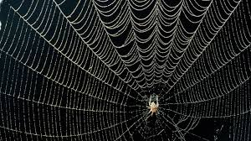
Key Concepts Woven in the Standards
Institutional mission
Integrity and honesty - institutional policies and actions
Student outcomes
Metrics and evidence to assess quality
Ongoing internal quality assurance practices
Continuous improvement for high performance

Slide 16
Intended Outcomes
To develop an ISER that the college and ACCJC can use as a meaningful and effective framework for fostering institutional excellence and student success.
To demonstrate how you exemplify academic quality and continue to improve.
The goal is quality not quantity!
Notes:
Not just bureaucratic exercise – use process to your own benefit for students benefit
The goal is an Institutional Self-Evaluation Report (ISER) that:
Reflects an authentic, collaborative, and mission-focused self-evaluation
Demonstrates how your college:
Aligns with Standards
Exemplifies academic quality
Continues to learn and improve
Serves as a framework for fostering ongoing institutional excellence and student success

Slide 17
Good Practices for the Self-Evaluation
Suggested process outlined in Guide to Institutional Self-Evaluation
Plan backward, and build in “slip time”
Keep the mission in mind
Discuss the Standard, gather the evidence, then write
Use the ISER template on accjc website
Address gaps and areas for improvement as you find them
Include as many people as possible in some aspect of the reflection
Communicate, communicate, communicate…and communicate again
Notes:
-ALO and team will manage process, set milestones, monitor progress, setting timeline for next 2.5 years

Slide 18
Developing the ISER
What criteria do you think will make a good ISER?
What values/skills do you believe are important for your college’s process?
Notes:
Typing in chat as activity
-Opportunity to clarify technical report, not historical drama, stick to standards, relevant evidence
-Communication, discussion on outcomes, what can be improved, organized, transparent

Slide 19
Mindset for ISER Development
Celebrate and appreciate what works well
Look for alignment with standards
Focus on outcomes
Evidence based analysis
Open-minded to improve
Valuing internal accountability
Holistic thinking across institutional systems
Mindful of mission accomplishment and values

Slide 20
Developing the ISER
Collaborative Partnership – multiple groups and perspectives working together!
Notes:
College stakeholder working together reflecting on institution strengths and areas of improvement in application of accreditation standards. Something about two sides of same coin….peer teams will do same

Slide 21
Comprehensive Peer Review
College
Self-Reflection
ISER
Team ISER Review
Standards Validation
Core Inquires
Off-Campus Site

Slide 22
Comprehensive Peer Review
College
Self-Reflection
ISER
Team ISER Review
Standards Validation
Core Inquires
Off-Campus Site
PEER REVIEW PROCESS
Focused Site Visit
Core Inquires
On-Campus Site
Team Report
Commission Action
(Affirmation)
College
Prep
College will have a few months from receipt of core inquires to prepare for focused site visit.

Slide 23
Formative/Summative Comprehensive Review Outcomes/Benefits
Reduce Fear
Eliminate
Surprise
Promote
Collegiality
Foster Trust
Increase
Transparency
Time to
consider team’s
Feedback
& plan
Emphasize
Improvement
Notes:
Eliminates surprises during Focused Site Visit
Reduces fear and anxiety
Allows you time to consider team’s feedback and make changes
Emphasizes institutional improvement and ongoing learning
Promotes collegiality between you and your peer review team
Increases transparency and trust
Reduces costs involved with the review process

Slide 24
Timeline for Comprehensive Review
Date | Activity
Fall 2022: | College began self-evaluation & ISER development
Dec. 15, 2024: | ISER due to ACCJC
Spring 2025: | Team ISER Review
Fall 2025: | Focused Site Visit
Jan 2026: | Commission Action

Slide 25
Approach (mindset) for Review
Starts with trusting the ISER and evidence
Seek to understand the college in the context of its mission
Practice appreciative inquiry
Respect / Appreciate college processes, practices and culture
Validation and affirmation (alignment with Standards)
Not hunting for deficiencies (not playing gotcha game)
Not reviewing against other regulations or requirements of other groups/entities
Triangulate all evidence and findings
Goal: assist college with improving educational quality and student learning
Outcome: team report – help the college to improve, and celebrate good practice
Excerpted from Team Training materials, Fall 2022

Slide 26
Outcomes | Innovations | Improvements
Institutional/Systems Based Review
Notes:
Kevin – 1.5 minutes
Relate back to the purpose of accreditation. Are colleges using their processes to ensure they’re meeting their missions?

Slide 27
Helpful Resources and Publications
Available on ACCJC’s website (accjc.org);
Eligibility Requirements
Standards of Accreditation
Commission Policies
Guides and Manuals
Educational Series
Webinars, conferences and symposiums
Ongoing trainings
News and Communications
Announcements
ACCJC Connect subscribe to or visit: https://accjc.org/accjc-connect/
Recent Commission Actions
Notes:
Pitch educational series – short videos https://accjc.org/educational-series/

Slide 28
Discussion
What concerns or questions do you have about the accreditation, ISER Development, the review process?

Slide 29
Nuts and Bolts: Interpreting Standards & Developing ISER

Slide 30
Overview: The Accreditation Evaluation Process
Self-Reflection (ISER)
Peer Review (Team ISER Review & Focused Site Visit)
Affirmation (ACCJC Action)
Ongoing Commitment to Improvement & Educational Excellence
Notes:
Reminder putting ISER in context – remember that there is external audience -- used by teams to judge your college and Commission to make decision, and ultimately public document

Slide 31
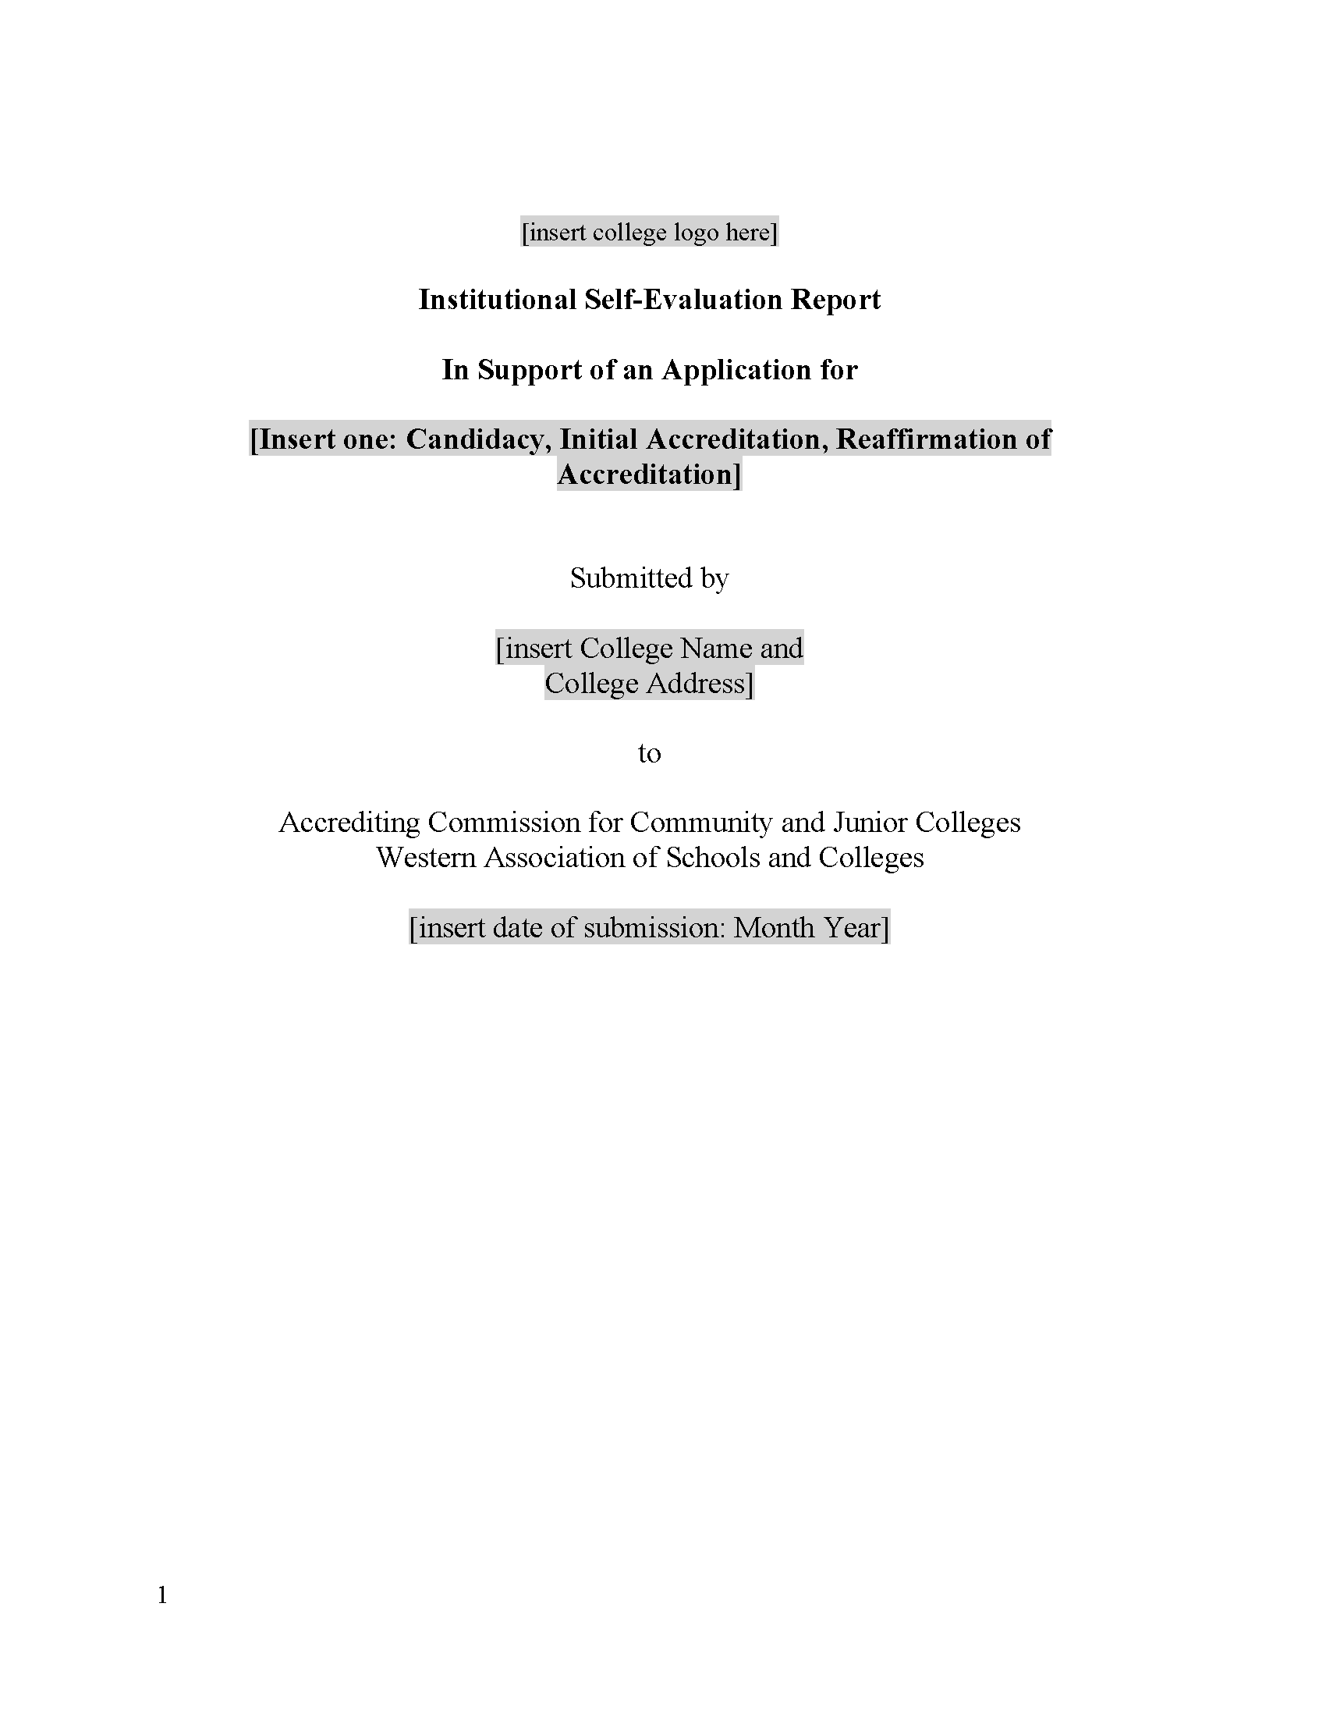
Key Resources:
Guide to Institutional Self-Evaluation, Improvement, and Peer Review
Required contents, formatting/structure suggestions, submission instructions, additional protocols, etc.
ISER Template
Word document with embedded formatting, structure, links to the Guide, etc.
Available on ACCJC website – Resources > Guides & Manuals
Notes:
Required elements, guidance, submission process, annotated Standards, review criteria, suggestions of possible evidence, “Policy Checklist,” DE protocol, etc.
USE the guide and template! Follow instructions, page limits!

Slide 32
Major Steps: Institutional Self Evaluation Process
Possible Steps of the Process:
Determine leaders.
Plan backward.
Invite others.
Discuss Standards Assign teams.
Gather evidence. Make changes.
Draft sections.
Compile the report.
Share with constituencies. Review and revise the report.
Share again?
Edit and finalize the report.
Get Board approval.
Submit.
Prepare for the Visit.
Notes:
Process layed out in Guide, seems simple but complex, ALO and steering committee will need to map out process and timeline
-real life perspective -- encourage to create a calendar with details and goals that allow many people to be involved. share perspectives such as how to be inclusive in process, how to keep people motivated, importance of communication – based on culture

Slide 33
Mission: Framework for Reflection and Review
Standard I
The institution demonstrates strong commitment to a mission that emphasizes student learning and student achievement.
Standard III
Standard IV
The institution effectively uses its human, physical, technology, and financial resources to achieve its mission and to improve academic quality and institutional effectiveness.
The institution recognizes and uses the contributions of leadership throughout the organization for promoting student success, sustaining academic quality, integrity, fiscal stability, and continuous improvement of the institution.
Standard II
The institution offers instructional programs, library and learning, and student support services aligned with its mission.
Notes:
The four Standards work together to define and promote student success, academic quality, institutional integrity, and excellence.
Review in the context of the mission. What does that mean. Standards are filled with swishing terms -- appropriate, sufficient, adequate. We don’t tell a college how to do something. We allow the institution to define these terms in relation to their mission. For example, Standard III.A.7 talks about the institution maintaining a sufficient number of qualified faculty. We don’t tell the institution what this number should be. It’s up to the institution to determine that number in relation to its mission. We’re looking to see that they have documented how they defined it, and are practicing/following it.

Slide 34
Four Interconnected Standards of Institutional Practice
Standard I
Standard II
Standard III
Standard IV
Mission
Instructional Programs
Human Resources
Decision-Making Roles & Processes
Physical Resources
Chief Executive Officer
Assuring Academic Quality & Institutional Effectiveness
Library & Learning Support Services
Technology Resources
Governing Board
Institutional Integrity
Student Support Services
Financial Resources
Multi-College Districts
Notes:
3 min. – quick review again -- 126 statements!
emphasize standards are descriptions of good practice; to provide guidance on what makes a quality institution, emphasize developed and revised through peer process, together improving what quality means
-Broadly written for application to diverse institutions: all institutions should be able to see themselves in those standards.
-Application varies by college.
-squishy terms
And they aren’t the easiest statements to understand sometimes.
Lead into exercise

Slide 35
Interpreting Individual Standards
Step 1: Use highest-level Standard area as your lens
For Example: Standard II.A.1
Standard II = Student Learning Programs and Services
Standard II.A = Instructional Programs

Slide 36
Interpreting Individual Standards
Step 2: Isolate the basic components of each sentence (i.e., subject, verb, direct object)
Standard II.A.1:
All instructional programs, regardless of location or means of delivery, including distance education and correspondence education, are offered in fields of study consistent with the institution’s mission, are appropriate to higher education, and culminate in student attainment of identified student learning outcomes, and achievement of degrees, certificates, employment, or transfer to other higher education programs.

Slide 37
UPCOMING ACTIVITY PURPOSE
To provide opportunity to discuss varying perspectives on the standard
To identify differences among standards which are related
To identify 1-2 pieces of evidence at your college which would demonstrate alignment
To provide opportunity to norm college’s interpretation and expectation to demonstrate alignment
Notes:
3 min
explain purpose and lead first step is to learn how to interpret standard

Slide 38
Group Activity - Interpreting the Standards
Break into groups.
Read assigned example standard in the handout.
Discuss the Standards interpretation and accompanying questions.
Determine sources of evidence.
Be prepared to discuss with the full group.
Notes:
BREAKOUT Activity 25 Minutes --
Goals:
Provide an opportunity to discuss varying perspectives on standards
Identify differences among standards that may seem overly similar
Identify 1-2 pieces of evidence that could demonstrate college’s alignment
Begin to norm college’s interpretations and expectations
5 min –explain assignment, provide handouts, have guide excerpts available to help
Note they will need to distinguish among similar sounding standards, how distinguish, how not redundant?
-lens of main standard
-detail or level of system under review
-policy or procedure

Slide 39
Share Out and Let’s Discuss
I.A.2 (Mission): The institution uses data to determine how effectively it is accomplishing its mission, and whether the mission directs institutional priorities in meeting the educational needs of students.
I.B.4 (Assuring Academic Quality and Institutional Effectiveness/Academic Quality): The institution uses assessment data and organizes its institutional processes to support student learning and student achievement.
I.B.5 (Assuring Academic Quality and Institutional Effectiveness/Institutional Effectiveness): The institution assesses accomplishment of its mission through program review and evaluation of goals and objectives, student learning outcomes, and student achievement. Quantitative and qualitative data are disaggregated for analysis by program type and mode of delivery.
Notes:
~5 min. per group

Slide 40
Share Out and Let’s Discuss
I.B.2 (Assuring Academic Quality and Institutional Effectiveness/Academic Quality): The institution defines and assesses student learning outcomes for all instructional programs and student and learning support services.
II.A.3 (Instructional Programs): The institution identifies and regularly assesses learning outcomes for courses, programs, certificates and degrees using established institutional procedures. The institution has officially approved and current course outlines that include student learning outcomes. In every class section students receive a course syllabus that includes learning outcomes from the institution’s officially approved course outline.
II.C.2 (Student Support Services): The institution identifies and assesses learning support outcomes for its student population and provides appropriate student support services and programs to achieve those outcomes. The institution uses assessment data to continuously improve student support programs and services
Notes:
~5 min. per group

Slide 41
Share Out and Let’s Discuss
I.C.8 (Institutional Integrity): The institution establishes and publishes clear policies and procedures that promote honesty, responsibility and academic integrity. These policies apply to all constituencies and include specifics relative to each, including student behavior, academic honesty and the consequences for dishonesty.
III.A.13 (Human Resources): The institution upholds a written code of professional ethics for all of its personnel, including consequences for violation.
IV.C.11 (Governing Board): The governing board upholds a code of ethics and conflict of interest policy, and individual board members adhere to the code. The board has a clearly defined policy for dealing with behavior that violates its code and implements it when necessary. A majority of the board members have no employment, family, ownership, or other personal financial interest in the institution. Board member interests are disclosed and do not interfere with the impartiality of governing body members or outweigh the greater duty to secure and ensure the academic and fiscal integrity of the institution.
Notes:
~5 min. per group

Slide 42
Share Out and Let’s Discuss
I.C.5 (Institutional Integrity): The institution regularly reviews institutional policies, procedures, and publications to assure integrity in all representations of its mission, programs, and services.
IV.A.7 (Decision-Making Roles and Processes): Leadership roles and the institution’s governance and decision-making policies, procedures, and processes are regularly evaluated to assure their integrity and effectiveness. The institution widely communicates the results of these evaluations and uses them as the basis for improvement.
IV.C.7 (Governing Board): The governing board acts in a manner consistent with its policies and bylaws. The board regularly assesses its policies and bylaws for their effectiveness in fulfilling the college/district/system mission and revises them as necessary.
Notes:
~5 min. per group

Slide 43
Pause and Reflect
What are your key takeaways from the activity?
What did you find particularly helpful?
How can this approach inform your ISER process?
What challenges do you anticipate as you get started?
Notes:
Note they will need to distinguish among similar sounding standards, how distinguish, how not redundant?
-lens of main standard
-detail or level of system under review
-policy or procedure or practice or outcome

Slide 44
Interpreting Standards – Steps to Success
Step 1: What area is the standard in?
Step 2: What is the standard about (i.e., subject, verb)
Step 3: What is the standard asking for (policy, process, documentation)?
Step 4: What’s the best evidence (not all evidence) that demonstrates the college is meeting standard?
Step 5: Write to the evidence

Slide 45
Structure of the Report
Title page
Certification page/signatures
Table of Contents
Introduction
Student achievement data and institution-set standards
Organization of the self-evaluation process
Organizational information
Compliance with ERs 1-5
Compliance with Commission policies
Analysis of Standards
Evidence of Meeting the Standard
Analysis and Evaluation
Conclusion
Quality Focus Essay
Notes:
follow template, in the guide, remember technical report not dissertation, start with understanding the standard and looking to your evidence first, then analyze, discuss, and write – analysis is heart of report

Slide 46
Structure of the Report
Evidence of Meeting the Standard
Indicates WHAT specific evidence demonstrates alignment with the Standard
Briefly describes the evidence in context of the standard to explain WHY it is relevant
This document demonstrates that the College…..
Analysis and Evaluation
Indicates HOW the evidence demonstrates alignment with the Standard
Evaluates the effectiveness of the policy, procedure, or practice in meeting the Standard
Conclusion at end of main sections
Provide a brief summary at a high, holistic level on the effectiveness of the College’s efforts towards the Standard
If the College determines improvements are needed, improvement plans should follow
Notes:
– tips and perspectives both as ALO and peer reviewer

Slide 47
Improvement Plans and the QFE
Self-Identified Improvement plans (a.k.a. planning agenda)
Purpose: Plans to strengthen college’s alignment to specific standards
Quality Focus Essay (QFE)
Purpose: Long term plans to improve student learning and achievement
Should identify outcomes, which are measurable and achievable
Should identify responsible parties/groups
Should have a timeline
Teams will provide feedback

Slide 48
Good Practices for Approaching the Report
Discuss the Standard, gather the evidence, then write
Use the ISER template (available on ACCJC website)
Keep the narrative clear, direct, and focused – use active voice
Use introductory sections to set the context and tone
Assign ERs 1-5 & Commission Policies with related Standards
“Freeze” evidence from websites in a PDF or screenshot

Slide 49
Good Practices for Evidence
Gather your evidence before you begin writing
More evidence is not necessarily better
Provide representative samples showing results of institutional processes
Use case studies as examples to demonstrate how processes/cycles are institutionalized
Call out relevant sections of large documents (highlights, excerpts, etc.)
Compare your evidence with Guide to Institutional Self-Evaluation
Notes:
Not historical novel, focus on most current and reasonable available

Slide 50
Heads Up – Distance Education
ACCJC Policy revisions adopted June 2021
Modified definitions for distance ed and correspondence ed
Federal regulation definitions for regular and substantive interaction

Slide 51
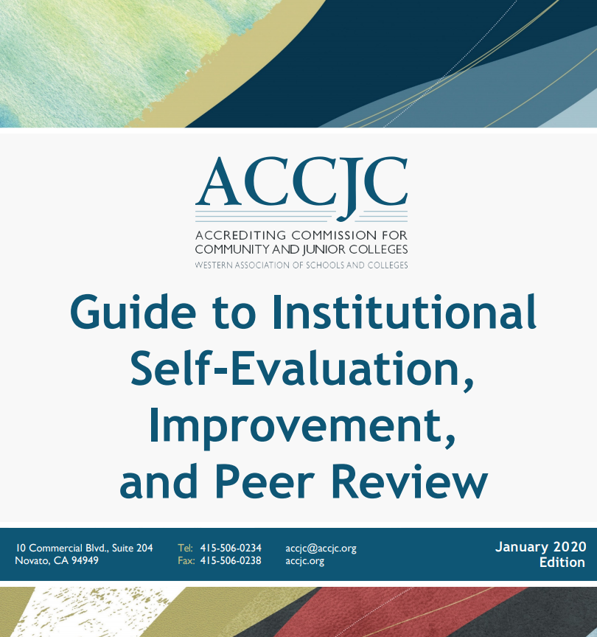
ISER Guide and Template
https://accjc.org/guides-and-manuals/

Slide 52
What Happens Next?
Fall 2022: ISER Training/Development
Dec. 15, 2024: ISER Due to ACCJC
Spring 2025: Team ISER Review (peer review)
Fall 2025: Focused Site Visit (peer review)
January 2026: Commission decision
Throughout the process: ACCJC training & support
Notes:
11:00 – 11:20am – slides 31 - 33
ISER production per your timelines
Analyze Standard
Gather evidence first
Identify Gaps
Make changes
Write report
Reviews process
Dec. 2022/Jan 2023 (60 days in advance of Team ISER Review) Report due to ACCJC

Slide 53
Remaining Questions and Comments & THANK YOU!

